Slide 1

Learning Python
Session 14 - Modules

Slide 2
Modules - Example
# Fibonacci numbers module
# save this in a file called fibo.py
#Modules are regular python programs
def fib(n): # write Fibonacci series up to n
a, b = 0, 1
while b < n:
print b,
a, b = b, a+b
def fact(n):
if n <= 0: return 1;
return fact(n-1);

Slide 3
Modules - Example
>>> import fibo
>>> fibo.fib(1000)
1 1 2 3 5 8 13 21 34 55 89 144 233 377 610 987
>>> fibo.__name__
'fibo'
#To use it often
>>> fib = fibo.fib
>>> fib(500)
1 1 2 3 5 8 13 21 34 55 89 144 233 377

Slide 4
Modules - Example
We can import few functions only.
>>> from fibo import fib, fact
>>> fib(500)
1 1 2 3 5 8 13 21 34 55 89 144 233 377
Or we can import all
>>> from fibo import *
>>> fib(500)
1 1 2 3 5 8 13 21 34 55 89 144 233 377

Slide 5
Modules - Differentiating
#save it as modls.py
if __name__ == "__main__":
print "Called as standalone";
else:
print "called as " + __name__;
$ python modls.py
Called as standalone
>>> import modls
called as modls

Slide 6
Modules - Search Path
First built-in modules are searched
Then, all the path in variable sys.path are searched
Current Program can modify sys.path

Slide 7
Compiled Python
It creates a .pyc for each .py
If can’t it ignores
To make it faster to load not run
It is based on modification time
.pyc contents are platform independent

Slide 8
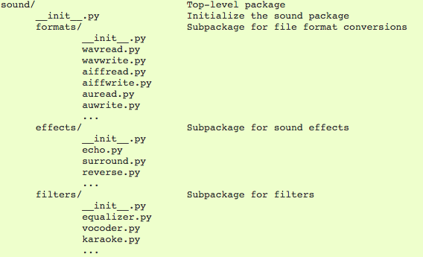
Packages
Load a subpackage
import sound.effects.echo
Absolute names to invoke:
sound.effects.echo.echofilter()
Or you also load in the following way
from sound.effects import echo
Then you can call:echo.echofilter()
Or you could
from sound.effects.echo import echofilter
echofilter()

Slide 9
Packages
A way of organizing the code in the form of A.B
In A.B, A is package and B is another package
In A.B, B is called subpackage
Code is organized in the form of Folders

Slide 10
Packages
__init__.py
__init__.py:
Every package folder should have a file named __init__.py
Even if empty

Slide 11
Packages & Sub Packages
A package folder can have other packages called subpackages
A package can import modules defined in parent or child in following manner:
from . import echo
from .. import formats
from ..filters import equalizer

Slide 12
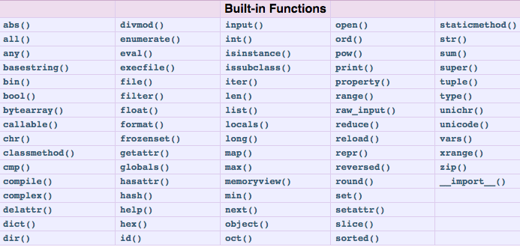
https://docs.python.org/2/library/functions.html

Slide 13
Useful Python Packages
PyGame - Game Development
PyGtk - Bindings for the cross-platform Gtk toolkit.
Matplotlib - Production quality output in a wide variety of formats
NumPy, SciPy - Includes modules for graphics and plotting, optimization, integration, special functions, signal and image processing, genetic algorithms ...
Django - High-level web framework.
Beautiful Soup - HTML/XML parser
pandas - Python Data Analysis Library, R Alternative
More at https://wiki.python.org/moin/UsefulModules

Slide 14
Questions?

